Slide 1
Mejor ruta Guayaquil - Quito
Aproximación usando Sistemas Expertos
Jess
Joe Cruz
Wellington Martinez
Erick Rocafuerte

Slide 2
AGENDA
INTRODUCCION
REQUIREMENT ANALYSIS
PROBLEM
GENERAL FEASIBILITY ANALYSIS
PROTOTYPE DESCRIPTION

Slide 3
INTRODUCTION
The tourism between Guayaquil and Quito is the higher in Ecuador, so the way between these cities is important to create a system to avoid the lack of communication in this way.

Slide 4
REQUIREMENT ANALYSIS
The route Guayaquil Quito has at least four ways to arrive to Quito, and on the way has much intermediate options to select, but only two highways are selected by the drivers, those are the Panamerican Highway, and the route by Santo Domingo de los Tsachilas.
Other issue is the high accident rate, this is the summarize of a lot problems on the way instead in cars and drivers.

Slide 5
REQUIREMENT ANALYSIS
The accident and its values of damage are the result of many factors as climate, state of the way, historical data about the accidents in the way, reckless drivers, so we did an investigation to experts, as Agencia Nacional de Transito ANT, INHAMI, OIAT.
At the beginning of the execution the program must be set a collection of accidents in the way between two cities, and then the program establish a new route between Guayaquil and Quito, underestimate the way who has the event.
Then the program will show the result of the execution and the steps to select that option in graphical format.

Slide 6
WHY JESS?
Jess has a big advantage over the others, this is the possibility to integrate to an IDE, this for educational purposes is important for fast development applications.
The integration to the IDE include check of mistakes, typing errors and suggest of Jess Function.
Other advantages is the use of a JAVA language to implement more modules around the Expert System, for example the adquisicion module and the result module.
The Jess languaje has the same modules of any expert system, the adquisicion module, resul module, engine and knowledge database.

Slide 7
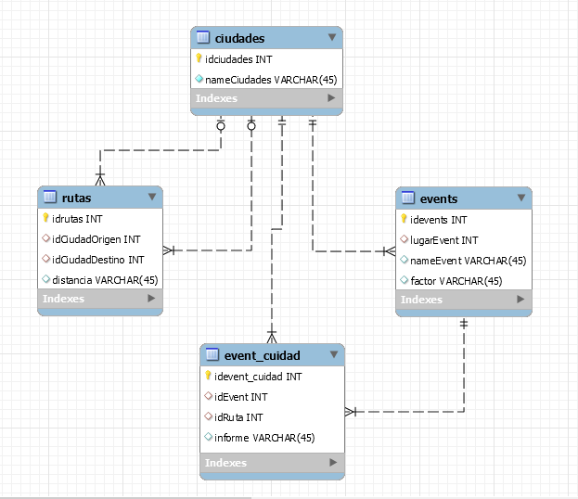
SOLUTION

Slide 8
SOLUTION
The conection between two cities, has a distance, and its associate with a “event” the event is any incident that could appear on the route Guayaquil Quito.
Every city has a event and its possibility to occur,

Slide 9
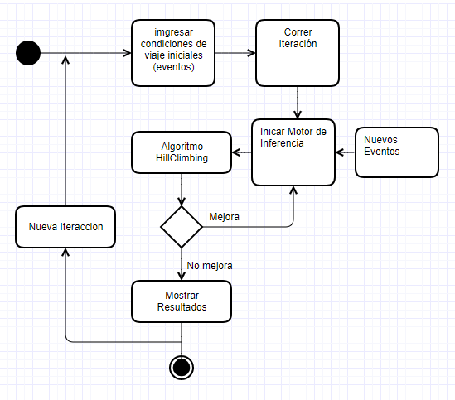
SOLUTION

Slide 10
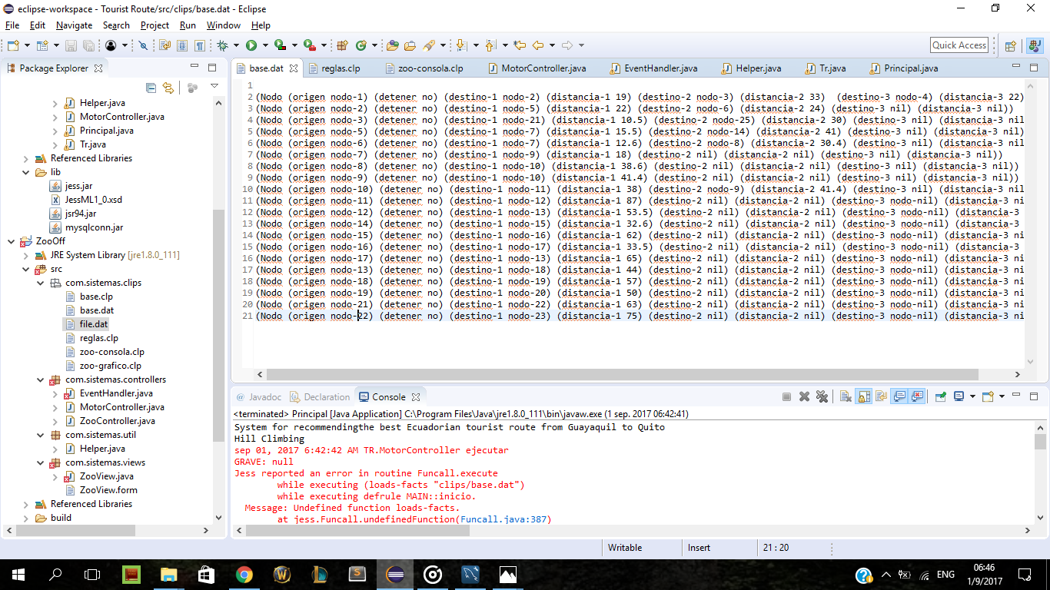
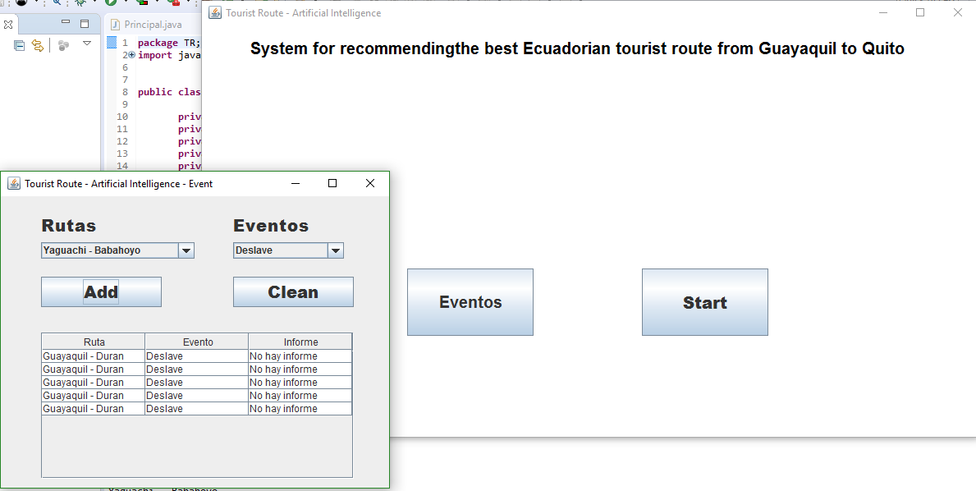
CAPTURES

Slide 11
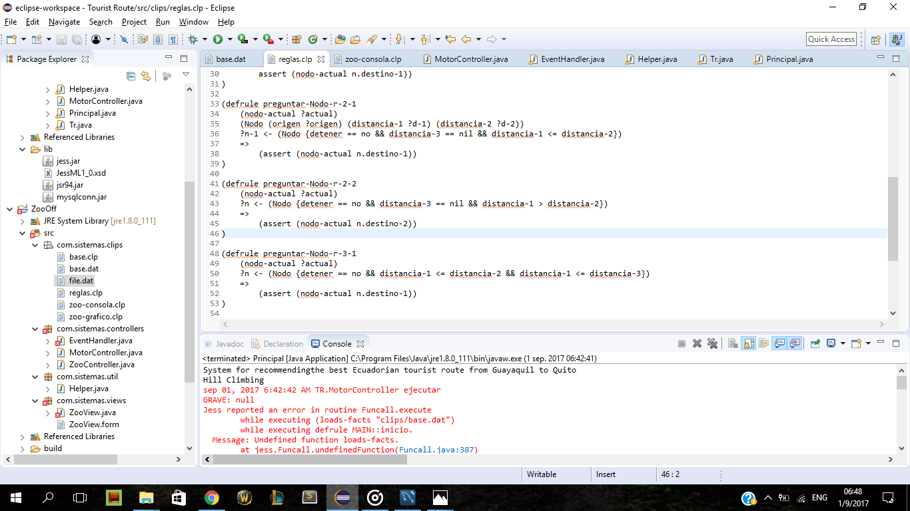
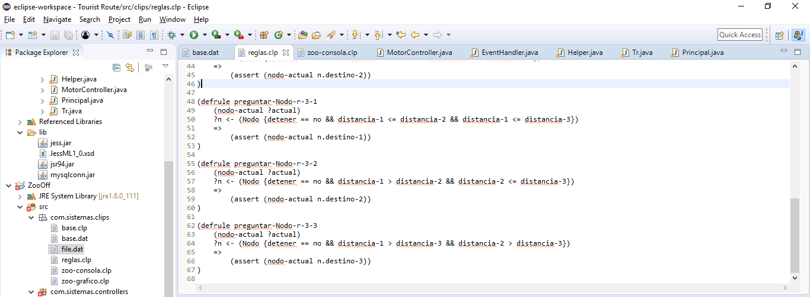
CAPTURES

Slide 12
RECOMENDATIONS
Use the functional language and its approach on a better way.
In the future could add in the Knowledge DB the climatic temperature in differents days.

